Slide 1
Go language
Anand Hariharan
Google Practice

Slide 2
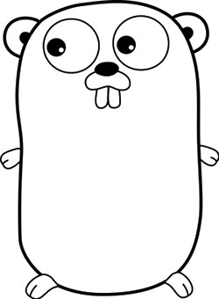
About Go
Developed by Google
By Robert Griesemer, Rob Pike & Ken Thompson
Started in 2007
Current Version 1.5.3, still being actively developed
Compiled, concurrent, garbage-collected, statically typed
Small language – only 25 keywords
Getting started
Download and install Go
https://golang.org/doc/install?download=go1.5.3.windows-amd64.msi
Install LiteIDE
http://sourceforge.net/projects/liteide/

Slide 3
Who uses Go?
Google, of course
Dropbox
Tumblr
Docker
Check below link for comprehensive list for all companies who uses Go! https://github.com/golang/go/wiki/GoUsers

Slide 4
Set up Go environment
Run go env
Set GOROOT to c:\Go
Set GOPATH to z:\<your-working-directory>
Usually a good practice to create 3 folders within your working directory and set GOBIN to \bin
src
bin
pkg
Refer slide note
Notes:
https://golang.org/doc/code.html

Slide 5
Go cross-compilation
set GOOS and GOARCH to be the values for the target operating system and architecture.
run go build -v YOURPACKAGE
If the compile is successful you’ll have a binary called YOURPACKAGE (possibly with a .exe extension if you’re targeting Windows) in your current working directory.
Notes:
https://golang.org/doc/install/source#environment

Slide 6
$GOOS and $GOARCH options
Choices for $GOOS are darwin (Mac OS X 10.7 and above and iOS), dragonfly, freebsd, linux, netbsd, openbsd, plan9, solaris and windows.
Choices for $GOARCH are amd64 (64-bit x86, the most mature port), 386 (32-bit x86), arm (32-bit ARM), arm64 (64-bit ARM), ppc64le (PowerPC 64-bit, little-endian), ppc64 (PowerPC 64-bit, big-endian), mips64le (MIPS 64-bit, little-endian), and mips64 (MIPS 64-bit, big-endian).
Notes:
https://golang.org/doc/install/source#environment

Slide 7
A Hello World program
package main
import (
"fmt"
)
func main() {
fmt.Println("Hello, world")
}

Slide 8

Packages
Every Go program is made up of packages.
The import keyword is how we include code from other packages to use with our program.
It is possible to import remote packages into Go
E.g.
Source: https://talks.golang.org/2012/splash.article

Slide 9
Variables, data hiding, package level member access
var statement declares a list of variables
var statement can be at package or function level.
The variable name itself carries information on whether a variable in Public or Private. This is determined by the case of the initial letter of the identifier
If the initial character is in upper case, the identifier is exported as Public, otherwise it is treated as Private:
<Name> is visible to clients of package
<name> (or <_Name>) - this is not visible to clients of the package
Source: https://golang.org

Slide 10
Short variable declaration
Inside a function, the := short assignment statement can be used in place of a var declaration with implicit type.
Outside a function, every statement begins with a keyword (var, func, and so on) and so the := construct is not available.
Source: https://golang.org

Slide 11
Program start point
Programs start running in package main.
Every Go program must start with a package declaration.
Packages are Go's way of organizing and reusing code.

Slide 12
Build and run a Go program
$> go build <filename.go>
This creates a .exe file (in Windows) in the same folder
build [-o output] [-i] [build flags] [packages]
Build compiles the packages named by the import paths, along with their dependencies, but it does not install the results.
If the arguments to build are a list of .go files, build treats them as a list of source files specifying a single package.
$> go run <filename.go>

Slide 13
Build and run a Go program
When compiling a single main package, build writes the resulting executable to an output file named after the first source file ('go build ed.go rx.go' writes 'ed' or 'ed.exe') or the source code directory ('go build unix/sam' writes 'sam' or 'sam.exe')
When compiling multiple packages or a single non-main package, build compiles the packages but discards the resulting object, serving only as a check that the packages can be built.

Slide 14
Basic data types
bool, string, int , int8, int16 , int32 , int64
uint uint8 uint16 uint32 uint64 uintptr – denoted unsigned integer
byte // same as uint8
rune // same as int32
float32, float64, complex64, complex128
Source: https://golang.org

Slide 15
Constants
Constants are declared like variables using the const keyword
Constants can be string, character, boolean or numeric
Constants cannot be declared using := syntax.
Source: https://golang.org

Slide 16
Working with Strings
Package “strings” implements simple functions to manipulate UTF-8 encoded strings
import “strings”
Common functions
Contains
Count
Index
Join
Replace
Split
ToLower
ToUpper
Trim
Notes:
Contains
ContainsAny
Count

Slide 17
Package “fmt” – useful functions
func Printf(format string, a ...interface{}) (n int, err error)
Printf formats according to a format specifier and writes to standard output
fmt.Println("Hello, playground")
//Print value and type
s:="wipro limited"
m,err:=fmt.Printf("Hello %v\n",s)
fmt.Println(m,"bytes written \n")
m,err=fmt.Printf("Type is %T\n",s)
//Boolean formatting
m,err=fmt.Printf("%t\n",7>8)
fmt.Println(m,"bytes written \n")
//Numeric formatting
m,err=fmt.Printf("%f\n",math.Sqrt(2))
m,err=fmt.Printf("%E\n",math.Sqrt(2))
Specifying width and precision
%f default width, default precision
%9f width 9, default precision
%.2f default width, precision 2
%9.2f width 9, precision 2
%9.f width 9, precision 0
Notes:
%v the value in a default format
%t the word true or false

Slide 18
Arrays, Slices, Maps, Range
Slice is a segment of an array
Like arrays, slices are indexable and have a length
Unlike arrays, length of slices is allowed to change
Maps
Known as hash or dictionary in other languages
Stores key value pairs
A key appears only once in a map
Range
Can be used to iterate over arrays, slices & maps

Slide 19
Flow control statements

Slide 20
For
Go has only one looping construct - for loop
Loop has three components separated by semicolons:
init statement: executed before first iteration
condition expression: evaluated before every iteration
post statement: executed at end of every iteration
init statement is often a short variable declaration
Variables declared visible only within the for statement
Loop stops iterating once boolean condition evaluates to false
Source: https://golang.org

Slide 21
Switch…case…default
Switch evaluation order
Switch cases evaluate cases from top to bottom, stopping when a case succeeds.
Source: https://golang.org

Slide 22
Defer
Defer statement defers the execution of a function until the surrounding function returns
Deferred call's arguments are evaluated immediately
The function call is not executed until the surrounding function returns
Source: https://golang.org

Slide 23
Functions & Return Values

Slide 24
Functions in Go – single and multiple return values
Functions in Go are declared with the keyword func()
A function can take zero or more arguments
A function can return any number of results
As a best practice, avoid “naked returns”
Examples
func add(x int, y int) int {
return x + y
}
func swap(x, y string) (string, string) {
return y, x
}
func swap(x, y string) (y1 string, x1 string) {
return y, x
}
Source: https://golang.org

Slide 25
Pointers

Slide 26
Pointers in Go
A pointer holds the memory address of a variable.
The type *T is a pointer to a T value. Its zero value is nil.
var p *int
The & operator generates a pointer to its operand.
The * operator denotes the pointer's underlying value.
This is known as "dereferencing" or "indirecting".

Slide 27
Examples
i:=10
p := &i
fmt.Println(p) //Prints memory address of i
fmt.Println(*p) //Prints value held in p
*p = 20
fmt.Println(p) //Prints memory address of i
fmt.Println(*p) //Prints value held in p
*p = 20/5
fmt.Println(*p) //Prints value held in p

Slide 28
Pointers to Structs
Struct fields can be accessed through a struct pointer.
To access the field X of a struct when we have the struct pointer p we could write (*p).X
Refer example

Slide 29
Passing pointer to a func()
type SKU struct {
StockID string
pinCode string
}
var (
s = SKU{"A123","560001"}
p = &s
)
func main() {
fmt.Print(checkAvailability(p))
}
func checkAvailability(p *SKU) (avl bool){
fmt.Println("Checking availability for", p.StockID)
return true
}

Slide 30
Variadic functions
Variadic functions can be called with any number of trailing arguments.
For example, fmt.Println is a common variadic function.
Example
func sum ( nums …int) (s int){
fmt.Print(nums, " ")
total := 0
for _, num := range nums {
total += num
}
fmt.Println(total)
}
func main() {
fmt.Println(sum(1,2,3,4))
n:=[]int{1,2,3,4}
fmt.Println(sum(n...)) //Can pass a slice to the function
}

Slide 31
Structs and OO in Go

Slide 32
Structs
Go's structs are typed collections of fields.
They're useful for grouping data together to form records.
Access struct fields with a dot.
An & prefix yields a pointer to the struct.
You can also use dots with struct pointers - the pointers are automatically dereferenced.

Slide 33
Anonymous Struct members
Go allows you to define a struct that has fields but with no variable names.
These fields are called anonymous fields.

Slide 34
Example
type Name struct {
firstName string `json:"fname"`
lastName string `json:"lname"`
}
type Address struct{
doorNumber string `json:"dnum"`
building string `json:"building"`
city string `json:"city"`
pin string `json:"pin"`
}
type Customer struct { //Example of an anonymous struct
Name
Address
}
var c = Customer{Name{"Anand", "Hariharan"},Address{"24","Electronic City","Bangalore","560001"}}

Slide 35
Interfaces
Interfaces in Go are:
A set of methods
A type

Slide 36
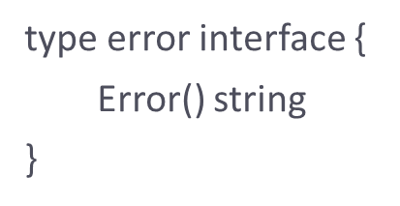
Error handling
For error handling, Go uses a pre-defined interface type called error
Errors are treated as values which can be programmed
Source: https://golang.org

Slide 37
Error handling
Since functions in Go can return multiple values, error is, by convention, the last return value of the function
func <func_name>(msg string) (string, error) {
// implementation
}
Alternatively, one can use the package ‘errors’ as well.

Slide 38
Examples
package main
import (
"errors"
"fmt"
"math"
)
func Sqrt(value float64) (float64, error) {
if value < 0 {
return 0, errors.New("Math: Negative number passed to Sqrt")
}
return math.Sqrt(value), errors.New("Math: No error")
}
func main() {
result, err := Sqrt(-1)
if err != nil {
fmt.Println(err)
} else {
fmt.Println(result)
}
result, err = Sqrt(9)
if err != nil {
fmt.Println(err)
} else {
fmt.Println(result)
}

Slide 39
Web clients
The net/http package provides a series of functions and types for sending HTTP requests.
The most important types are:
the Client
the Request
the Response

Slide 40
Web clients
The Client type offers some other methods related directly to the HTTP methods:
Client.Get
Client.Post
Client.PostForm
Client.Head
and the equivalent helper functions:
http.Get
http.Post
http.PostForm
http.Head

Slide 41
Gorilla mux
Gorilla is a web toolkit for the Go programming language. Currently these packages are available:
gorilla/context stores global request variables.
gorilla/mux is a powerful URL router and dispatcher.
gorilla/reverse produces reversible regular expressions for regexp-based muxes.
gorilla/rpc implements RPC over HTTP with codec for JSON-RPC.
gorilla/schema converts form values to a struct.
gorilla/securecookie encodes and decodes authenticated and optionally encrypted cookie values.
gorilla/sessions saves cookie and filesystem sessions and allows custom session backends.
gorilla/websocket implements the WebSocket protocol defined in RFC 6455.
The name mux stands for "HTTP request multiplexer"
to install the mux package in your machine you can use go get
$ go get github.com/gorilla/mux

Slide 42
Main features of mux
Requests can be matched based on URL host, path, path prefix, schemes, header and query values, HTTP methods or using custom matchers.
URL hosts and paths can have variables with an optional regular expression.
Registered URLs can be built, or "reversed", which helps maintaining references to resources.
Routes can be used as subrouters: nested routes are only tested if the parent route matches. This is useful to define groups of routes that share common conditions like a host, a path prefix or other repeated attributes. As a bonus, this optimizes request matching.
It implements the http.Handler interface so it is compatible with the standard http.ServeMux.

Slide 43
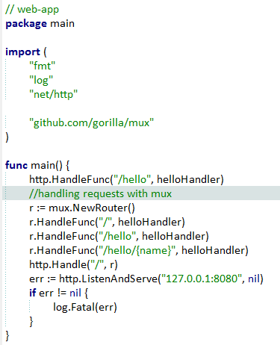
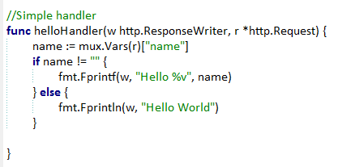
Example – Simple routing

Slide 44
Concurrency
Implemented using
goroutines
channels
select
goroutine is an independently executing function executed by the “go” statement
Goroutines are multiplexed into a small number of OS threads
They don’t map 1:1 with OS threads
Growable, segmented stacks which startup faster than threads
Go routines communicate via channels
Channel provides a connection between two goroutines allowing them to communicate
See http://tleyden.github.io/blog/2014/10/30/goroutines-vs-threads/ for more info

Slide 45
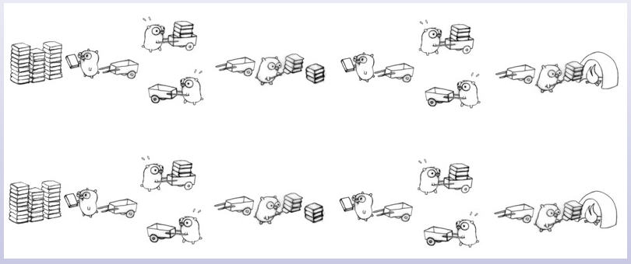
Visualizing concurrency

Slide 46
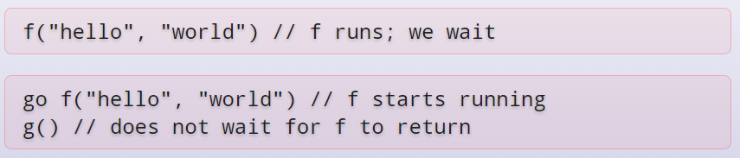
Example
Program execution begins by initializing the main package and then invoking the function main. When that function invocation returns, the program exits. It does not wait for other (non-main) goroutines to complete.

Slide 47
Channels
Use make(chan val-type) to create a new channel
Channels are typed by the values they convey

Slide 48
Tools
gofmt
A formatter for Go code
gofix
Helps in code updates/refactoring (e.g. update of APIs)
Source: https://golang.org

Slide 49
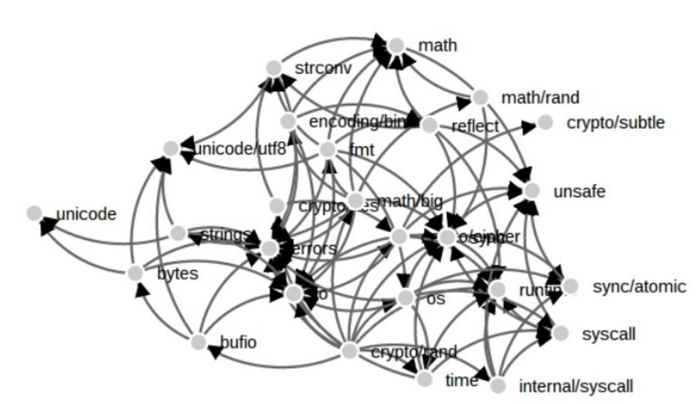
Why dependency management?
Dependencies: Some golang file which is needed to run another golang file
http://www.slideshare.net/ramitsurana/dependency-management-in-golang

Slide 50
godeps
One of the more popular tools for dependency management
Installing godeps
$ go get github.com/tools/godep
Using godeps
godep save
Exports all dependencies to a JSON file
save a list of dependencies to the file Godeps/Godeps.json and copy their source code into vendor/
Read over the contents of vendor/ and make sure it looks reasonable. Then commit the Godeps/ and vendor/ directories to version control.

Slide 51
godeps – common operations
The godep restore installs the package versions specified in Godeps/Godeps.json to your $GOPATH.
Edit-test Cycle
Edit code
Run godep go test
Add a Dependency
To add a new package foo/bar, do this:
Run go get foo/bar
Edit your code to import foo/bar.
Run godep save (or godep save ./...).
Update a Dependency
To update a package from your $GOPATH, do this:
Run go get -u foo/bar
Run godep update foo/bar. (You can use the ... wildcard, for example godep update foo/...).
Multiple Packages
If your repository has more than one package, run godep save ./... to capture the dependencies of all packages in your application.

Slide 52
Sample godeps file
{
"ImportPath": "github.com/kr/hk",
"GoVersion": "go1.6",
"Deps": [
{
"ImportPath": "code.google.com/p/go-netrc/netrc",
"Rev": "28676070ab99"
},
{
"ImportPath": "github.com/kr/binarydist",
"Rev": "3380ade90f8b0dfa3e363fd7d7e941fa857d0d13"
}
]
}

Slide 53
Anand Hariharan
Practice Head
anand.hariharan@wipro.com

Slide 54
Basic Go commands
build - compile packages and dependencies
clean - remove object files
doc - show documentation for package or symbol
env - print Go environment information
fix - run go tool fix on packages
fmt - run gofmt on package sources
generate - generate Go files by processing source
get - download and install packages and dependencies
install - compile and install packages and dependencies
list - list packages
run - compile and run Go program
test - test packages
tool - run specified go tool
version - print Go version
vet - run go tool vet on packages

